Slide 1
Merger Remedies -
Commission’s recent practice
Bratislava, 14 May 2014
                Viktor PORUBSKÝ
                Merger Case Support and Policy
                DG Competition

Slide 2
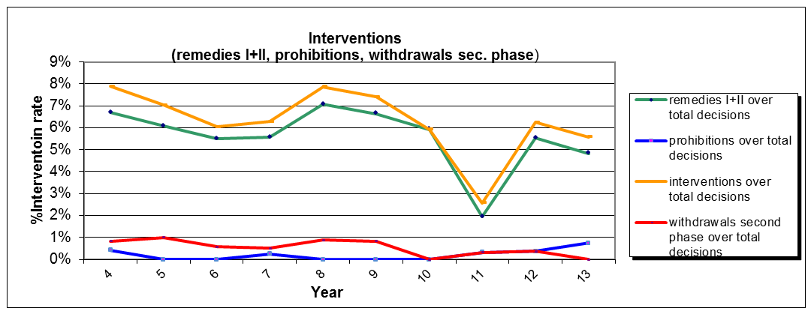
Commission’s Intervention in merger cases 2004-2013

Slide 3
  What type of remedies are accepted?
Clear preference for structural remedies:
Divestitures:
  Divestiture of a stand-alone business remains the norm
  Open to consider other/complex divestitures (asset carve-outs, re-branding, divestiture of brands/IPRs) if appropriate safeguards
  Removal of links with related companies if those problematic
Occasionally behavioural remedies in the form of:
  Access remedies in appropriate cases if as effective as structural remedies

Slide 4
Remedies choice - guiding principles
See Commission's Remedy Notice
Only Parties can offer commitments
Basic conditions for acceptable remedies:
  Comprehensive and effective, capable to eliminate the competition concerns entirely
  Capable of being implemented within a short period of time
  Divestiture remedies: ensuring viability and competitiveness of the divested business
Remedies subject to general principle of proportionality (but have to entirely remove concerns – Cemetbouw)

Slide 5
Divestiture of a stand-alone business
Kraft/Cadbury
Chocolate confectionary in various EU Member States
Concerns in Polish chocolate tablet and pralines markets and Romanian chocolate tablets market
Clear-cut divestiture remedy:
  PL: Wedel business (Cadbury‘s “Polish traditional” confectionary business under the Wedel brand) including trademarks, franchising businesses and 2 manufacturing facilities
  RO: Kandia business (the Cadbury domestic chocolate confectionary and soft cake business in Romania), including several trademarks and manufacturing facilities

Slide 6
Divestiture of a stand-alone business
Unilever/Sara Lee Body Care
  Concerns in deodorants markets in several countries
  Remedy rationale - removal of overlap (Sanex)
  Initial proposals with risks on viability:
    splitting the brand for deos and shower gels, plus alongside country borders
    temporary brand licencing and re-branding for purchaser
  Accepted remedy: entire EU Sanex business

Slide 7
Complex divestitures: carve-out
Carve-outs can be acceptable if
  They meet the same criteria (viable, competitive) and
  Additional safeguards to remedy the implementation risks (such as a limited pool of purchasers, risk of deterioration of the competitiveness or saleability of the business)
Which safeguards:
  Purchaser criteria: e.g. buyer has to be active or has recent experience in the industry so that he can integrate the divestment business into its existing business
  Up-front buyer (or fix it first) if limited pool of purchasers or risk of preserving competitiveness
  If no up-front buyer: Crown-jewel commitment?
  Reverse carve-outs

Slide 8
Complex divestitures: carve-out
Crane/MEI
  Merger of the two strongest players for certain types of payment handling systems, concerns in 2 markets
  Remedy:
  Carve-outs of the relevant businesses: software, patents, trademarks, personnel, sales/marketing etc
  Safeguards:
    Strict purchaser criteria
    Up-front buyer clause

Slide 9
Complex divestitures
  UPS/TNT Express
  Concerns in 15 national markets for intra-Europe next day services
Proposed remedies
  Not a stand-alone biz, but divestiture of local subsidiaries in 15 origin countries + temporary access to UPS' air network
  Viability+competitiveness critically depends on buyer
    Need to connect divested assets to a functioning existing network
  -> up-front buyer or fix-it first needed (safeguards)
  Parties unable to offer up-front or fix-it first buyer
  La Poste/DPD as a potential buyer would also be unsuitable due to weakness of network (notably no air network)
No sufficient safeguards -> prohibition

Slide 10
Access remedies
Intel / McAfee
Competition concerns: foreclosure/exclusion of rivals in IT security and creation of monoculture in IT security
Remedies :
  Provision of interoperability information
  No impediment of security rivals’ solutions from running on Intel CPUs and chipsets

Slide 11
Role of Trustees
Monitoring trustee
  Appointed by the parties with the approval of the Commission
  Supervises the implementation of the commitments on behalf of the Commission, for example:
    Business separation
    Hold-seperate obligations
    Preservation of viability in the interim period
    Evaluation of purchasers
    Access remedies: overseeing the process, disputes
  Divestiture trustee
  Appointed (by the parties and approved by the Commission) if biz not sold within 1st divestiture period
  Task to sell the business to a suitable purchaser for no minimum price (“fire sale”)

Slide 12
Thank you for your attention
Disclaimer: the contents of this presentation are the views of the author and do not necessarily represent an offiocial position of the European Commission

