Slide 1
Remedies in a Failing Firm Situation
Bratislava
14 May, 2014
Maria Ulfvensjö Baltatzis

Slide 2
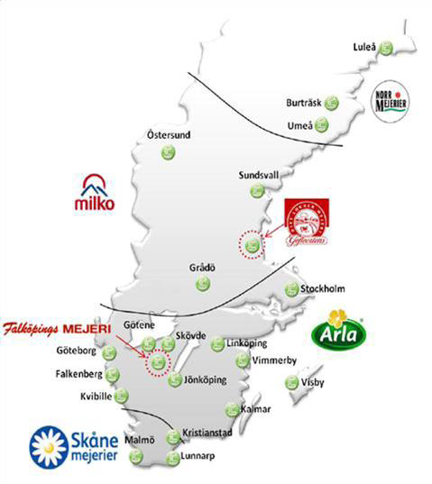
The Merger
Arla no. 1 dairy in Sweden – by far!
Milko no. 3 dairy in Sweden
Both parties agricultural cooperatives
Fresh dairy products rarely transported over long distances
Parties’ “traditional areas of distribution” share a long, densely populated border
Milko had a long “non-profit history”, but did initially not claim failing firm

Slide 3
Competition between Parties
Product | Findings
Fresh milk Plain youghurt Plain soured milk | In some areas: Close competition between parties Little competition from other producers
Flavoured yoghurt Flavoured soured milk Cream-based products | Competition not particularly close Significant competition from other producers
Butter | Massive joint market share at national level Potential for competition from imported butter
High transport cost
Low transport cost
Long life milk a niche product in Sweden – not close substitute to fresh milk!

Slide 4
The Failing Firm-Defense
Parties claimed no merger-specific effects due to Milko being about to fail
The SCA applied the 3 criteria test set out in the European Commission’s guidelines on horizontal mergers

Slide 5
Analysis of Criteria 1 and 2
Criterion 1: the SCA accepted that Milko would fail absent merger
Criterion 2: the SCA could not see that there were other, less anti-competitive merger options
  Milko argued plausibly that it had historically explored other merger opportunities, which had failed
  Merger opportunities restricted by the fact that Milko was a cooperative
Criteria 1 and 2 satisfied, and failure scenario became the relevant counterfactual to the merger

Slide 6
Analysis of Criterion 3
Criterion 3: the parties and the SCA did not agree on the fate of Milko’s assets in case of Milko failing
  Both Arla and the SCA made an analysis of what would happen in case of Milko’s failure
  Predicted outcomes were similar – but not identical
  Differences between predicted outcomes formed the basis for discussion on merger-specific effects

Slide 7
Failure Scenario
Areas of agreement
  Most of Milko’s suppliers (i.e. dairy farmers) of raw milk would switch to supply Arla instead
  Some suppliers of raw milk would leave the market all together
  Insolvent Milko would quickly become unable to operate as a going concern due to lack of raw milk
  Assets would be liquidated by administrator
Areas of disagreement
  The fate of Milko’s assets when liquidated
  Different views on which transactions that were likely

Slide 8
Milko’s Assets
Asset | Products affected | Interested buyers
Grådö processing facility | Fresh milk Plain yoghurt Plain soured milk Cream-based products
Östersund processing facility | Butter Powdered milk
Brands | Yoghurt Soured milk

Slide 9
Merger-Specific Effects Compared to Milko being Liquidated
Grådö facility and brands
Could plausibly be sold to a dairy other than Arla
Could plausibly exert competitive pressure on Arla when taken over by other dairy
Merger-specific effect for fresh dairy in the vicinity of Grådö, and for certain kinds of fresh dairy (important brands in the Milko region)
Östersund facility
No evidence of potential buyers
No merger-specific effect in the otherwise potentially problematic market for butter

Slide 10
The Remedy Package
Arla undertook to divest the Grådö facility
  Reserve price set according to estimated scrap value in order to ensure that package did not go beyond identified merger-specific effects
Arla undertook to divest several of Milko’s brands
  No reserve price
Östersund facility not included due to no evidence of potential buyers

Slide 11
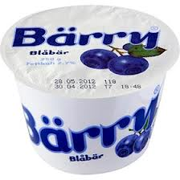
Outcome
Brands divested almost immediately by Arla
  Sold to several different smallish, established dairies
Grådö divested in autumn 2012 by Trustee
  “Several” bidders in auction
  At least one competitor to Arla participated
  In the end, Coop (a retail chain) won the auction
  Coop now an alternative buyer of raw milk in the former Milko-region

Slide 12
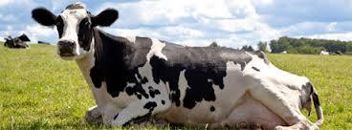
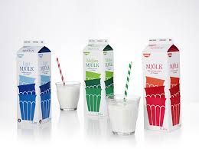
Happy End
Coop Cow
Coop Milk

