Slide 1
"Imbalances" in the food supply chain: The Commission's approach and recent initiatives at the EU level Conference on Current Trends in Slovak and European Competition Law Bratislava, 14 May 2014
An Renckens
Member of the Food Task Force
DG Competition, European Commission
The views expressed in this presentation are personal and do not commit the European Commission

Slide 2
Outline presentation
General trends and overview of concentration and imbalances in the food supply chain
Buyer power versus bargaining power
Approach of the Commission and Member States
Policy instruments
Recent initiatives at the EU level
Work on Unfair Trading Practices (UTPs);
Retail study DG COMP;
CAP reform

Slide 3
(1) General trends and overview of imbalances in the food supply chain

Slide 4
Trends and observations in the food supply chain
In 2008/2009: Concerns about food prices and pass-through of food commodity price changes in the chain
Rising food prices and increased volatility in food commodity prices
Asymmetric price transmission along the food supply chain
More recently: Concerns about buyer-supplier relationships in the chain and the impact of retailers' practices on investment in choice and innovation
Concerns about increased concentration of big retail chains and international food manufacturers
While many SMEs are active in the food sector and the primary level of the food supply chain remains fragmented
And these imbalances would lead to competition violations and unfair trading practices (UTPs), having an impact on choice and innovation in the long run

Slide 5
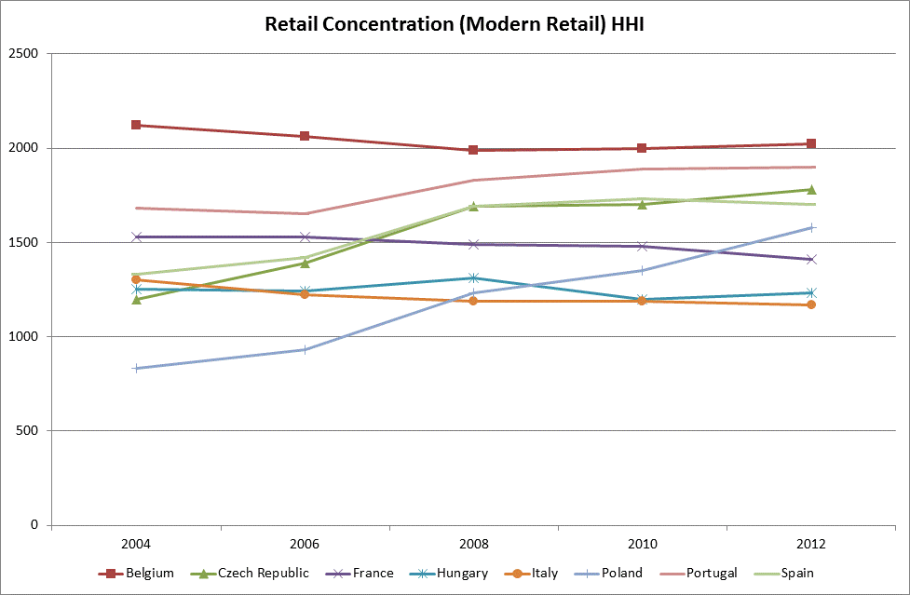
Retail concentration (HHI at national level)
HHI = measure of concentration based on the sum of squared market shares ϵ [0; 10,000]

Slide 6
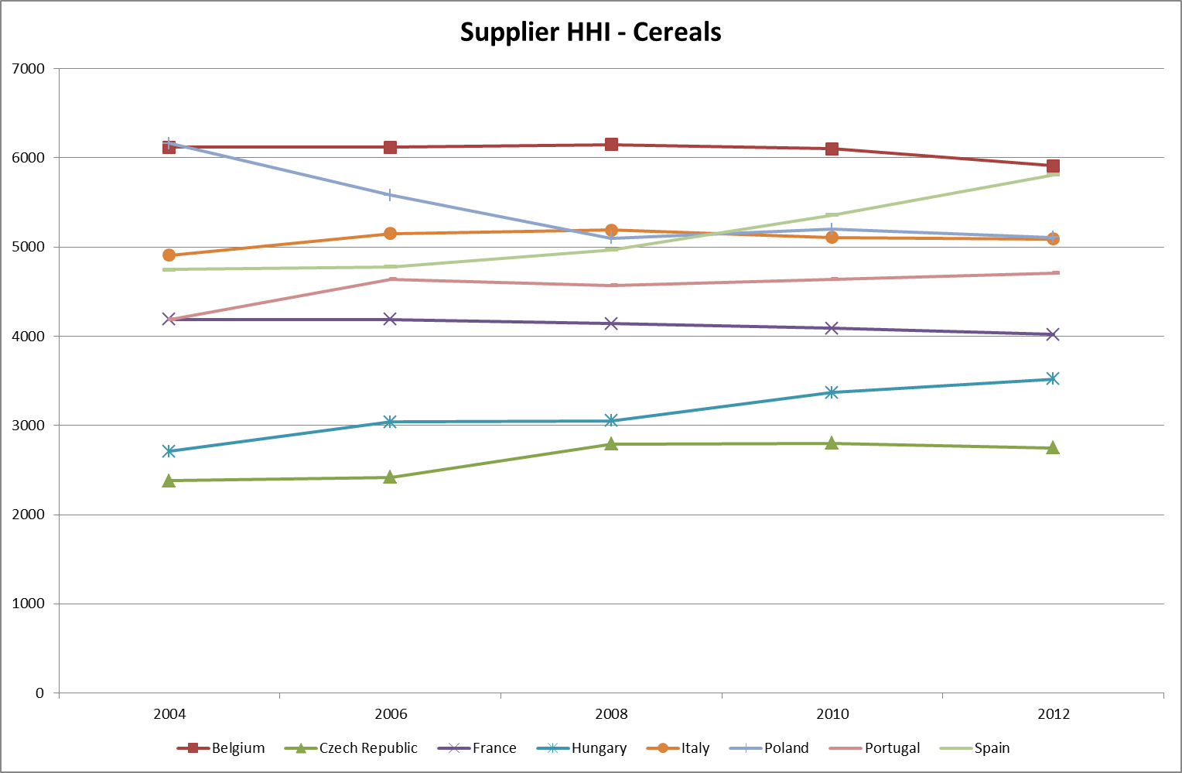
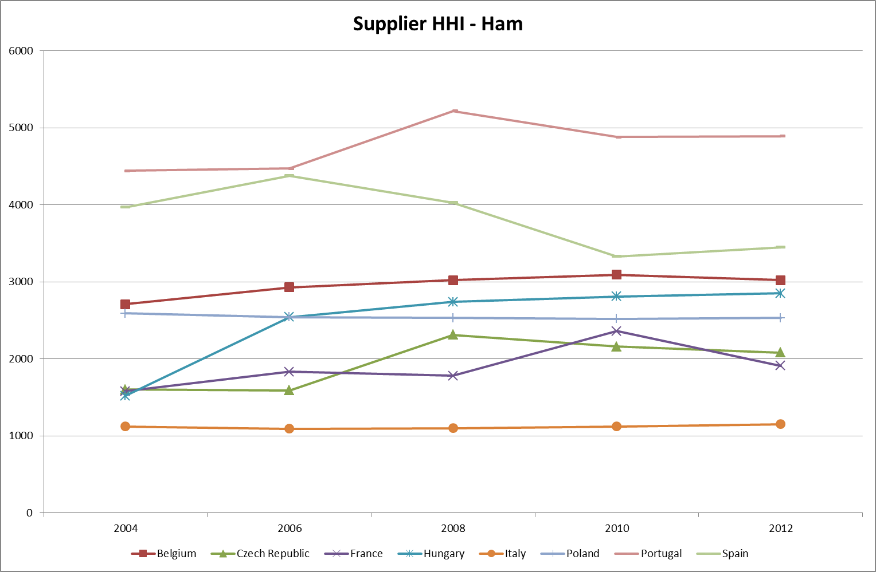
Supplier concentration (HHI at national level)
Supplier concentration is generally
higher for cereals than for ham,
but differences between MS

Slide 7
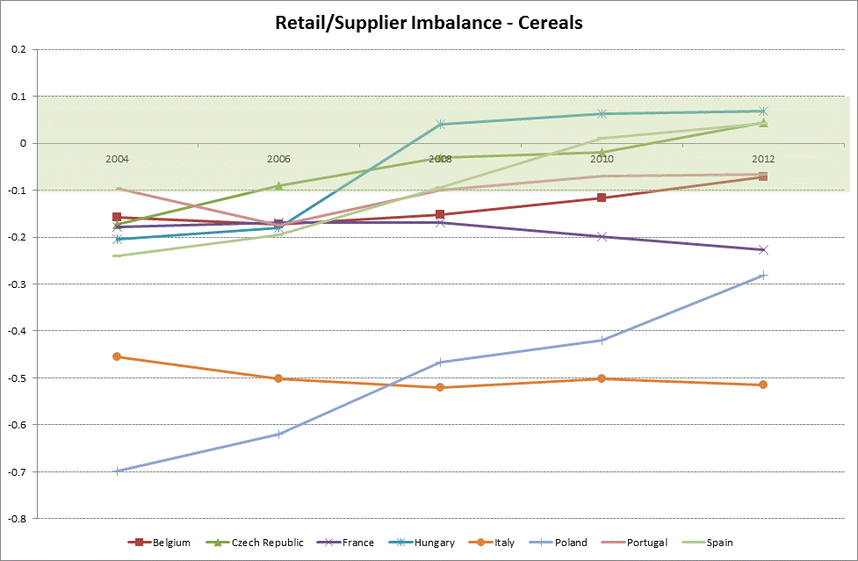
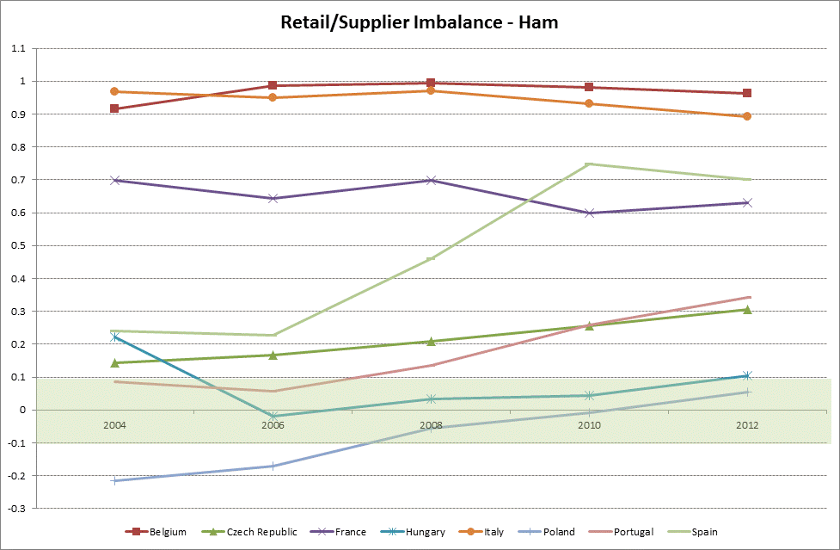
Imbalance between retailers and suppliers
Cereals: the supply side of the market is
in general more concentrated than the retail side
Ham: the retail side of the market is in
general more concentrated than the supply side

Slide 8
(2) Buyer power versus bargaining power

Slide 9
Buyer power and bargaining power are conceptually different issues
Competition law | Contract law/fair trading law
Objective : protection of competition on the overall market, no protection of competitors (as individual companies)! → consumer welfare | Objective : regulation of contractual relationships between companies, irrespective of their effect on the market → fair distribution of economic rents
Focus on market power (e.g. buyer power) | Focus on bargaining power
Efficiency gains can be balanced against negative anticompetitive effect | Fairness is considered

Slide 10
(a) Buyer power
EC's approach towards buyer power:
Short run: Buyer power is not per se bad when the benefits are passed on to the end consumer
Positive impact on consumer welfare => no competition issue
Potential long run impact of buyer power on the investment in innovation and choice
Negative impact on consumer welfare => competition issue
Lack of strong evidence so far => Retail study DG COMP
Instruments to deal with abuse of buyer power:
Competition law
Current EU competition law instruments are considered to be sufficient to deal with potential abuses of buyer power
Cf. Vertical Guidelines, BER, etc.
However, change in competition rules for the agricultural sector! Cf. CAP reform

Slide 11
(b) Bargaining power – Approach at EU and national levels
EC's approach towards bargaining power:
Explicit demarcation between anticompetitive behaviour and unfair trading practices under Regulation 1/2003
Competition law is usually not considered to be the appropriate tool to address conflicts/unfair trading practices in bilateral negotiations since it is hard to show effects on the entire market and harm to consumer welfare
But in some cases overlap can exist; E.g. Tying by a dominant supplier can be a bilateral unfair trading issue with impact on consumer welfare (cf. Coca-Cola case)
Member States' approach towards bargaining power:
There is not always a clear distinction within competition law (cf. at national level laws exceeding the scope of Art.102 may exist)
Recently many Member States and national competition authorities have been advocating the adoption/implementation of legislation or codes of good practice

Slide 12
(b) Bargaining power – Policy instruments
At EU level:
Competition law (Art.102 – Abuse of a dominant position): limited application!
Food sector: Voluntary code of good practices under the High Level Forum for a Better Functioning Food Supply Chain
Other policy options currently under consideration
At Member State level:
Contract law or civil law in many Member States (generally not considered to give sufficient protection against UTPs)
Competition law: Art.102 and national laws on economic dependency/superior bargaining power going beyond the application of Art.102
E.g. Czech Republic (Act on significant market power in the sale of agricultural and food products; implemented by the Office for Protection of Competition), Germany, France (DGCCRF has powers to intervene), Portugal (competition law revised in 2012 to include abuse of economic dependence)
Specific legislation on unfair trading practices
E.g. UK: the groceries supply code of practice (2008) + independent adjudicator (2013), Slovakia (Law Nr. 362/2012, Unfair Terms in Foodstuff Act), Poland (Act on Unfair Competition), Hungary (Ban on unfair practices of distributors in relation to agricultural products and the food industry towards suppliers (2010)), Latvia (draft Law on the prohibition of unfair retail practices), Italy (Art.62)
Codes of conduct/good practices + national implementation/dialogue platform
E.g. Belgium, the Netherlands, Portugal (PARCA), Finland

Slide 13
(3) Recent initiatives to address imbalances at the EU level

Slide 14
(3.1) Unfair Trading Practices (UTPs): Imbalances in general

Slide 15
Background
European Parliament calling for actions to tackle Unfair Trading Practices (UTPs)
Several resolutions, latest one passed on 19 January 2012
Complaints from food manufacturers and consumer associations that choice and innovation have deteriorated
No compelling empirical evidence of effects at market level so far

Slide 16
Initiatives on UTPs at EU level
High Level Forum for a Better Functioning Food Supply Chain: Expert Platform on B2B Contractual Practices set up in 2010 – results:
Agreement on a code of good practices in 2011
All operators but farmers agreed on an implementation mechanism in 2012, which has been launched on 16 September 2013
Dialogue with Copa-Cogeca (the farmers' association) is maintained
Green Paper and public consultation (Q1 2013)
Impact Assessment (on-going)

Slide 17
(3.2) Retail study DG COMP: Imbalances between food retailers and food manufacturers

Slide 18
WHY? 2 main objectives retail study
Objective 1:
Providing economic input to the discussion on unfair trading practices (UTPs)
Cf. Green paper and Impact Assessment on UTPs initiated early 2013:
Main arguments about the effects of UTPs :
Capacity to invest and innovate affected through UTPs => detrimental effect on choice and innovation
Single Market affected through existence of fragmented national rules => detrimental effect on cross-border sourcing and distribution
Objective 2:
Answer the calls of the Parliament to check if competition is working in the retail sector in Europe
Is this true?

Slide 19
WHAT? Subject of retail study
Analysis of the evolution of choice and innovation at local level
Analysis of the potential drivers of choice and innovation at local and national level:
Concentration related factors: retail concentration (at national and consumer catchment area level), supplier concentration, ratio of both (measure of imbalance in bargaining power and scope for UTPs)
Other factors: shop type, shop size, private label penetration, socio-demographic variables, economic growth/crisis,…

Slide 20
HOW? Type of analysis
Descriptive statistics
Factual description of how choice and innovation have been evolving over time
Factual description of how the drivers of choice and innovation have been evolving over time
Econometric analysis
To identify a possible relationship between the evolution of choice and innovation and their drivers
To identify the most relevant factors that could explain the evolution of choice and innovation
Case studies
To complement the quantitative/econometric analysis:
Analysis of some bulk fresh products (fruit and vegetables, meat)
Analysis of products close to the agricultural level of the food supply chain (milk, cheese, olive oil)

Slide 21
(3.3) CAP Reform: Imbalances between farmers and their buyers (retailers/food industry/wholesalers)

Slide 22
Background of the CAP reform
The Common Agricultural Policy (CAP) concerns a large part of the EU budget (about 40%)
Varied calls for a reform:
assigning/developing new duties to farming (environmental protection, sustainability)
ensuring a competitive agricultural sector
improving the economic situation of farmers

Slide 23
Tough negotiations between European Parliament (EP) and Council
CAP reform discussions focused upon the farmers' position in the value chain, in particular, their lack of bargaining power vis-à-vis their buyers
EP proposal: create wide-ranging exceptions to competition rules in particular to allow farmers to jointly sell and fix prices without limit
Problems with this proposal:
Not efficient
Not sustainable in the long run
Negative impacts on consumer

Slide 24
Outcome negotiations and next steps
EP proposal was not accepted and compromise solution was agreed:
Introduction of an exemption from competition rules for farmers active in the olive oil, beef and arable crops sectors who are organised in Producer Organisations (POs) and engage in joint selling, under certain conditions:
Creation of efficiencies
Below certain market share ceilings
Next steps:
The Commission will publish Guidelines to clarify the implementation of the new rules
Stakeholders are able to express their views in the context of the public consultation

Slide 25
Thank you!

